Slide 1

Correlation of National level factors with Covid-19.
Eliot Cleveland
Gina Freed
Marc Leslie

Slide 2
Motivation and Overall Summary
Motivation & Summary Slide
Richer and more developed countries should fair better during the pandemic
Look at various factors we believed might be at play
Determined that there may be information bias – higher GDP countries had better testing and reporting
We thought transparency might play a role

Slide 3
Dataset
Independent Variables: Population, GDP, HDI, CPI, Cases
Dependent Variables: Cases, Deaths

Slide 4
Data exploration, clean up & analysis
Clean up
Had to drop some data because some countries weren’t reporting certain criteria
Exploration
Looked at different timepoints
Looked at different independent variables
Analysis
Determined …
Go to Notebook

Slide 5
Regressions

Slide 6
HDI

Slide 7
Maps

Slide 8
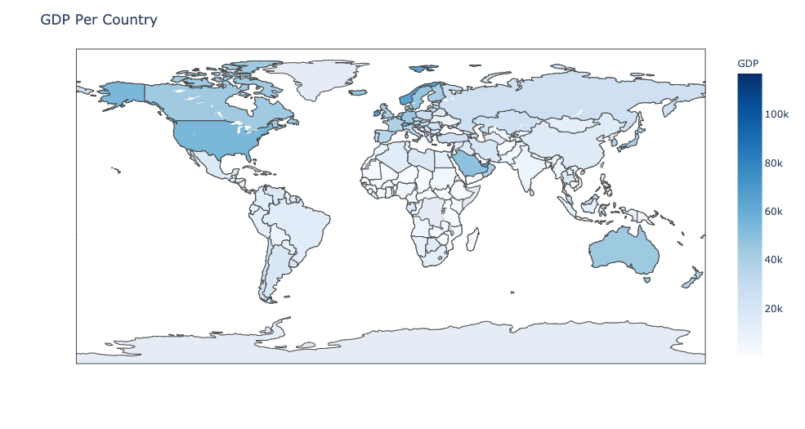
GDP
Blah blah blah, very important things about what we assumed

Slide 9
GDP Scatter

Slide 10
Population

Slide 11
Transparency

Slide 12
Challenges
Uniformity in reporting was lacking

Slide 13
Suggestions Future Research
Likely an information bias
Need data for percent positivity or tests per capita by county
Examples of this data fell woefully short but potentially could be piecemealed together
Look at more granular data
Lots of noise at the national level
Population/population density not well understood at national level
Need more vaccination data

